Slide 2

Certification Management Subsystem
Nhi Le | 13.06.2024

Slide 3

Agenda
Mindmaps
Use case diagram
UI Designs
Database Designs
References
Q&A

Slide 4
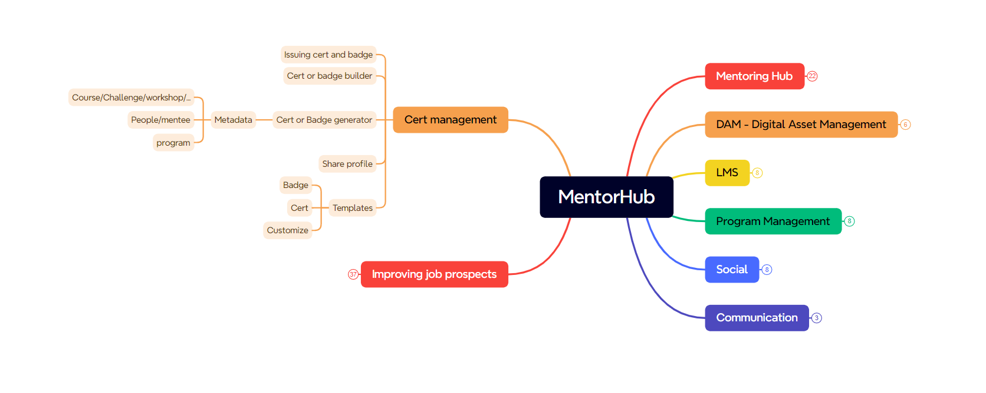
MentorHub

Slide 5
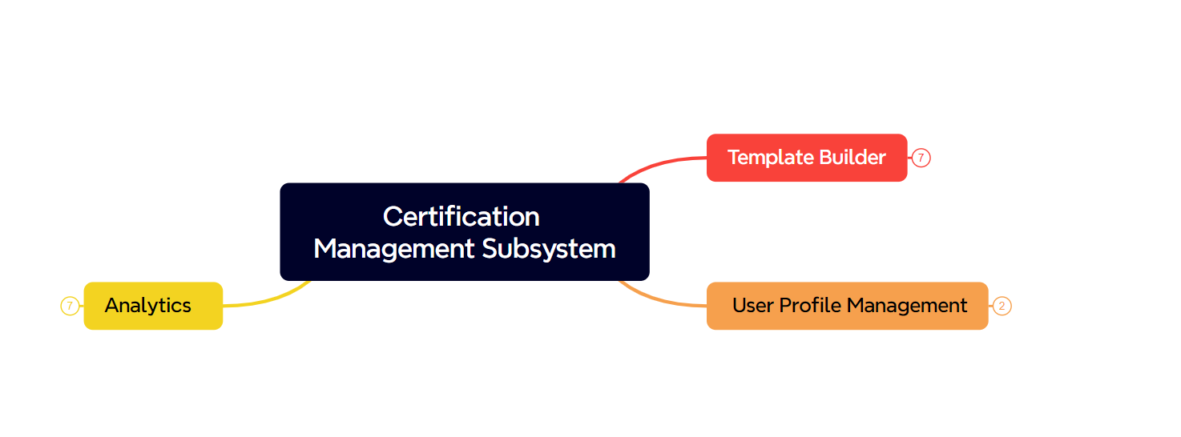
Certificate Management Subsystem

Slide 6
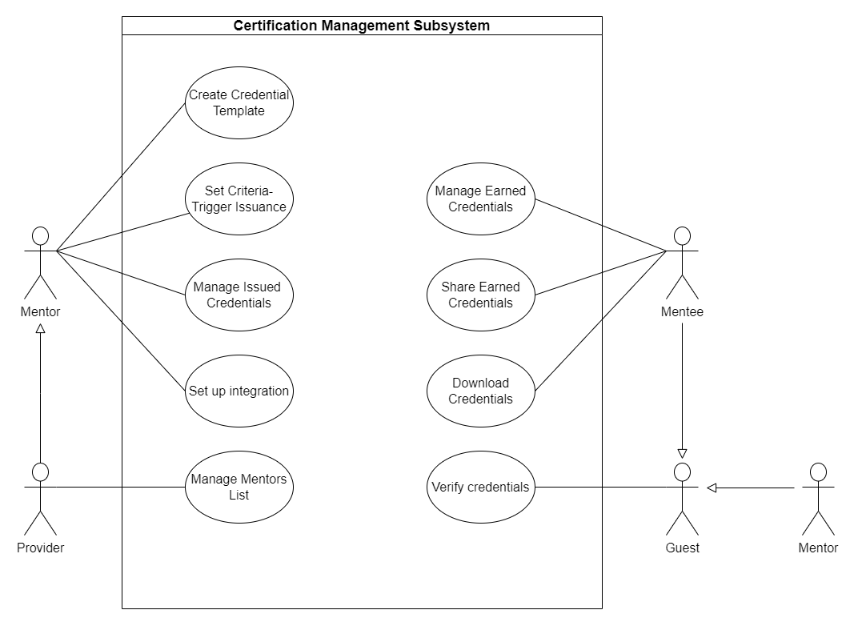
Use case diagram

Slide 7
Mentor
Mentor Home
Mentor Dashboard
Mentor Email Templates
Mentor Integration

Slide 8
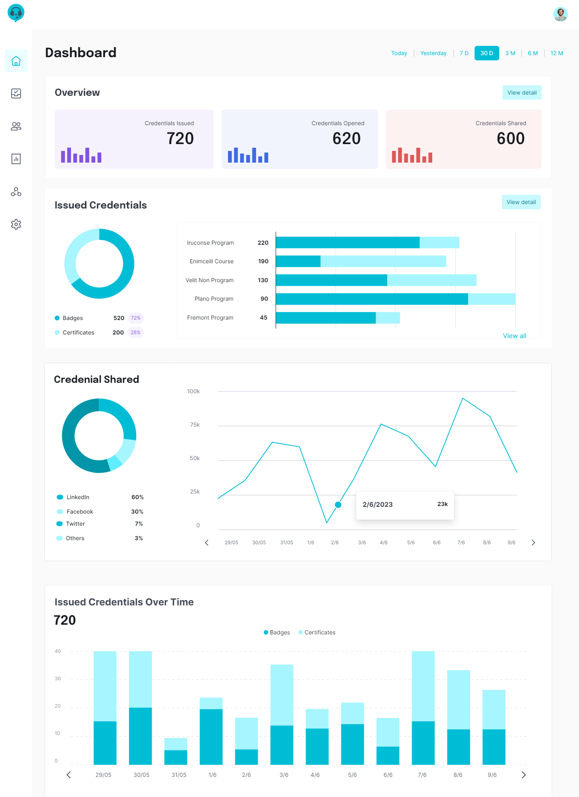
Mentor Dashboard

Slide 9
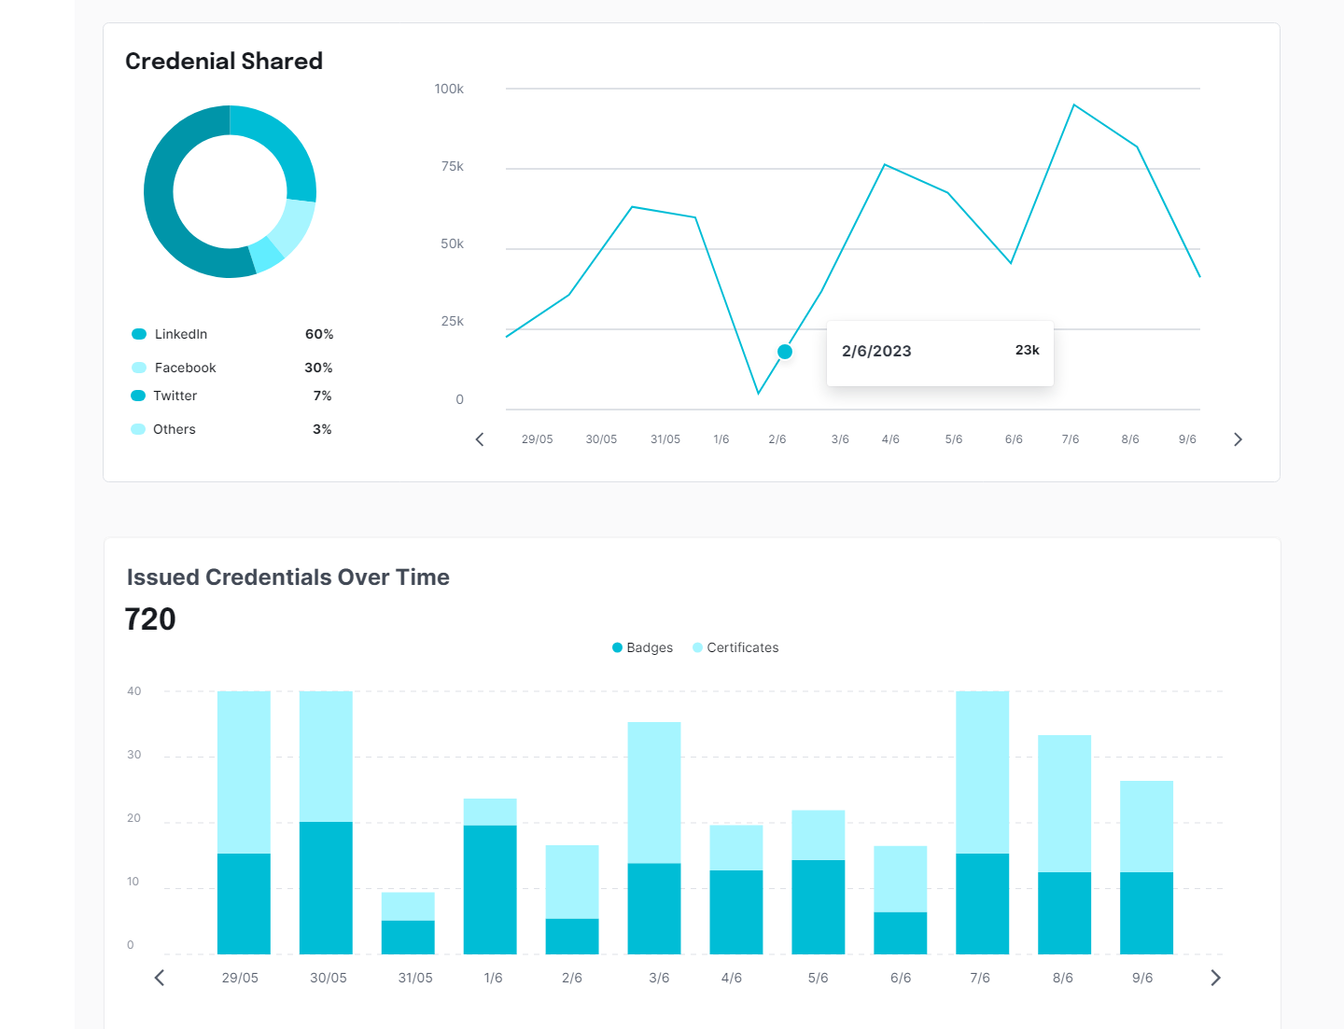
Mentor Dashboard

Slide 10
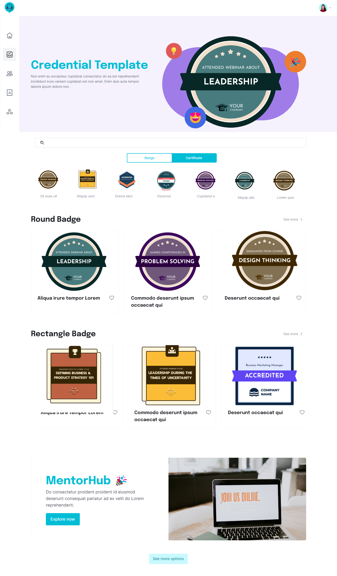
Mentor Badge Template

Slide 11
Mentor Badge Template

Slide 12
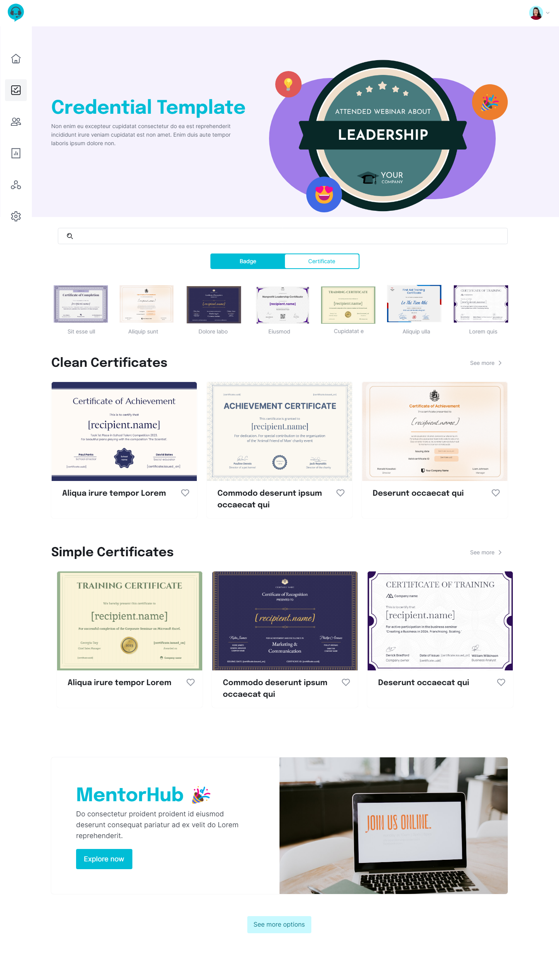
Mentor Certificate Template

Slide 13
Mentor Certificate Template

Slide 14
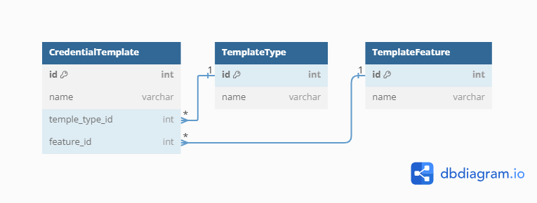
Database Design

Slide 15
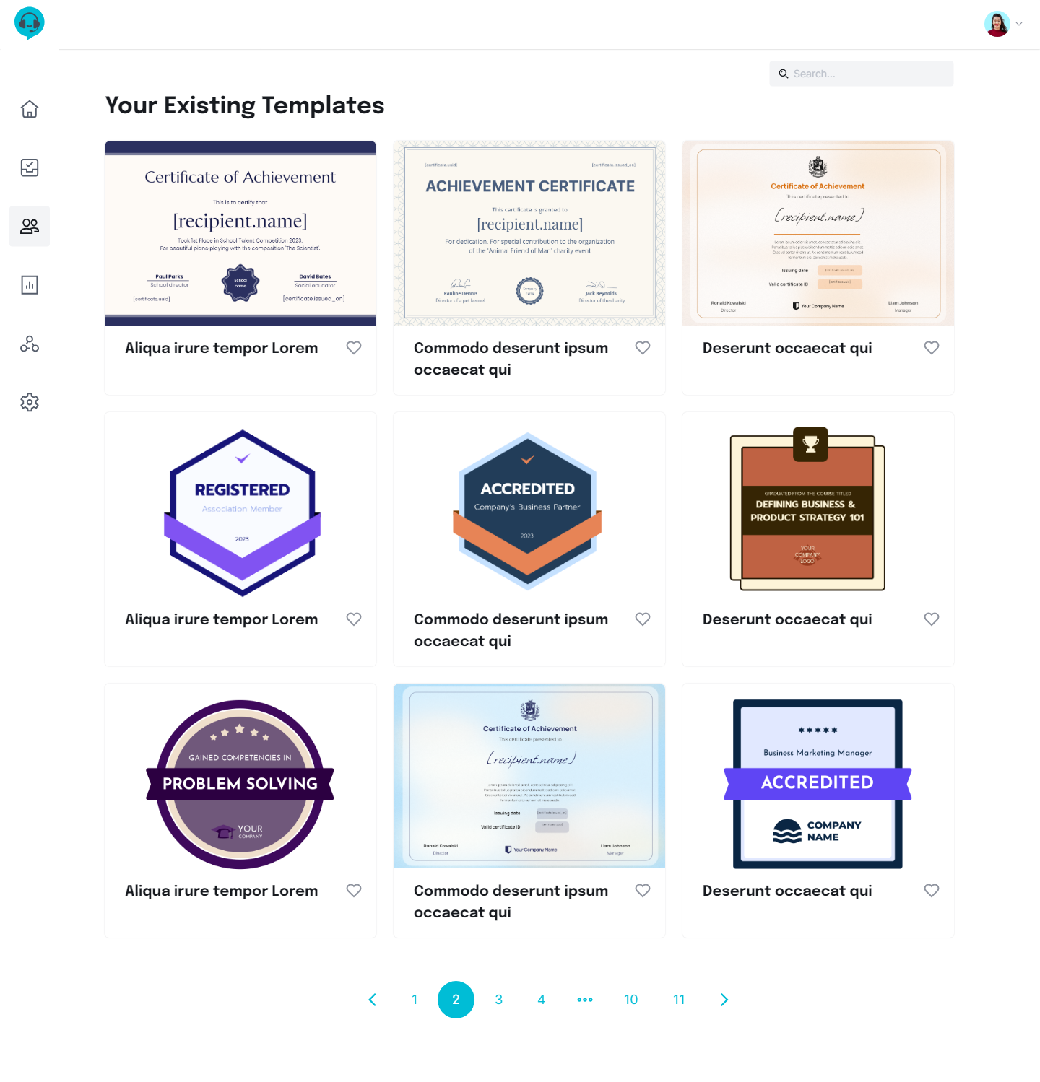
Mentor Existing Template

Slide 16
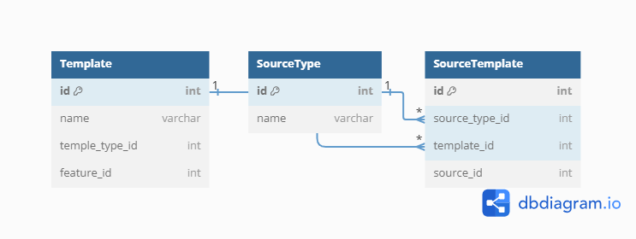
Mentor Existing Template

Slide 17
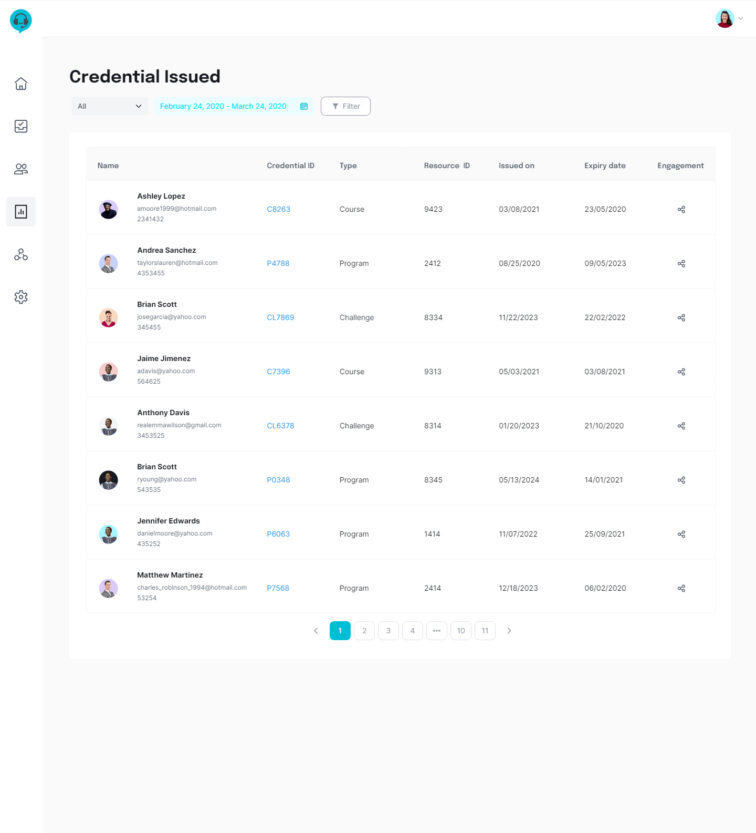
Mentor Credential Issued

Slide 18
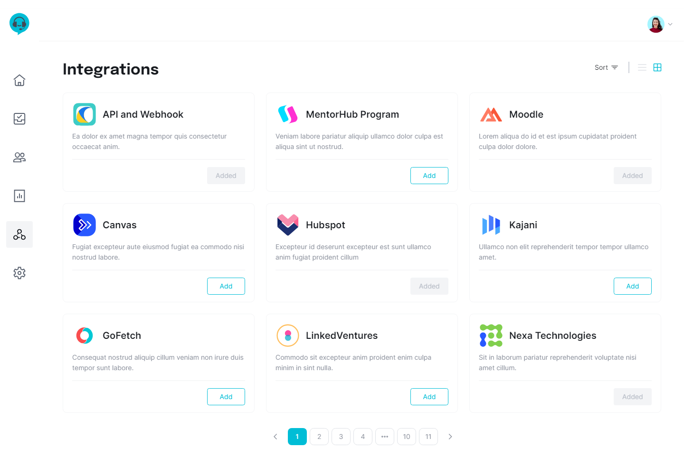
Mentor Integrations

Slide 19
Mentee
Mentee Profile
Mentee Verification
Mentor Email Templates
Mentor Integration

Slide 20
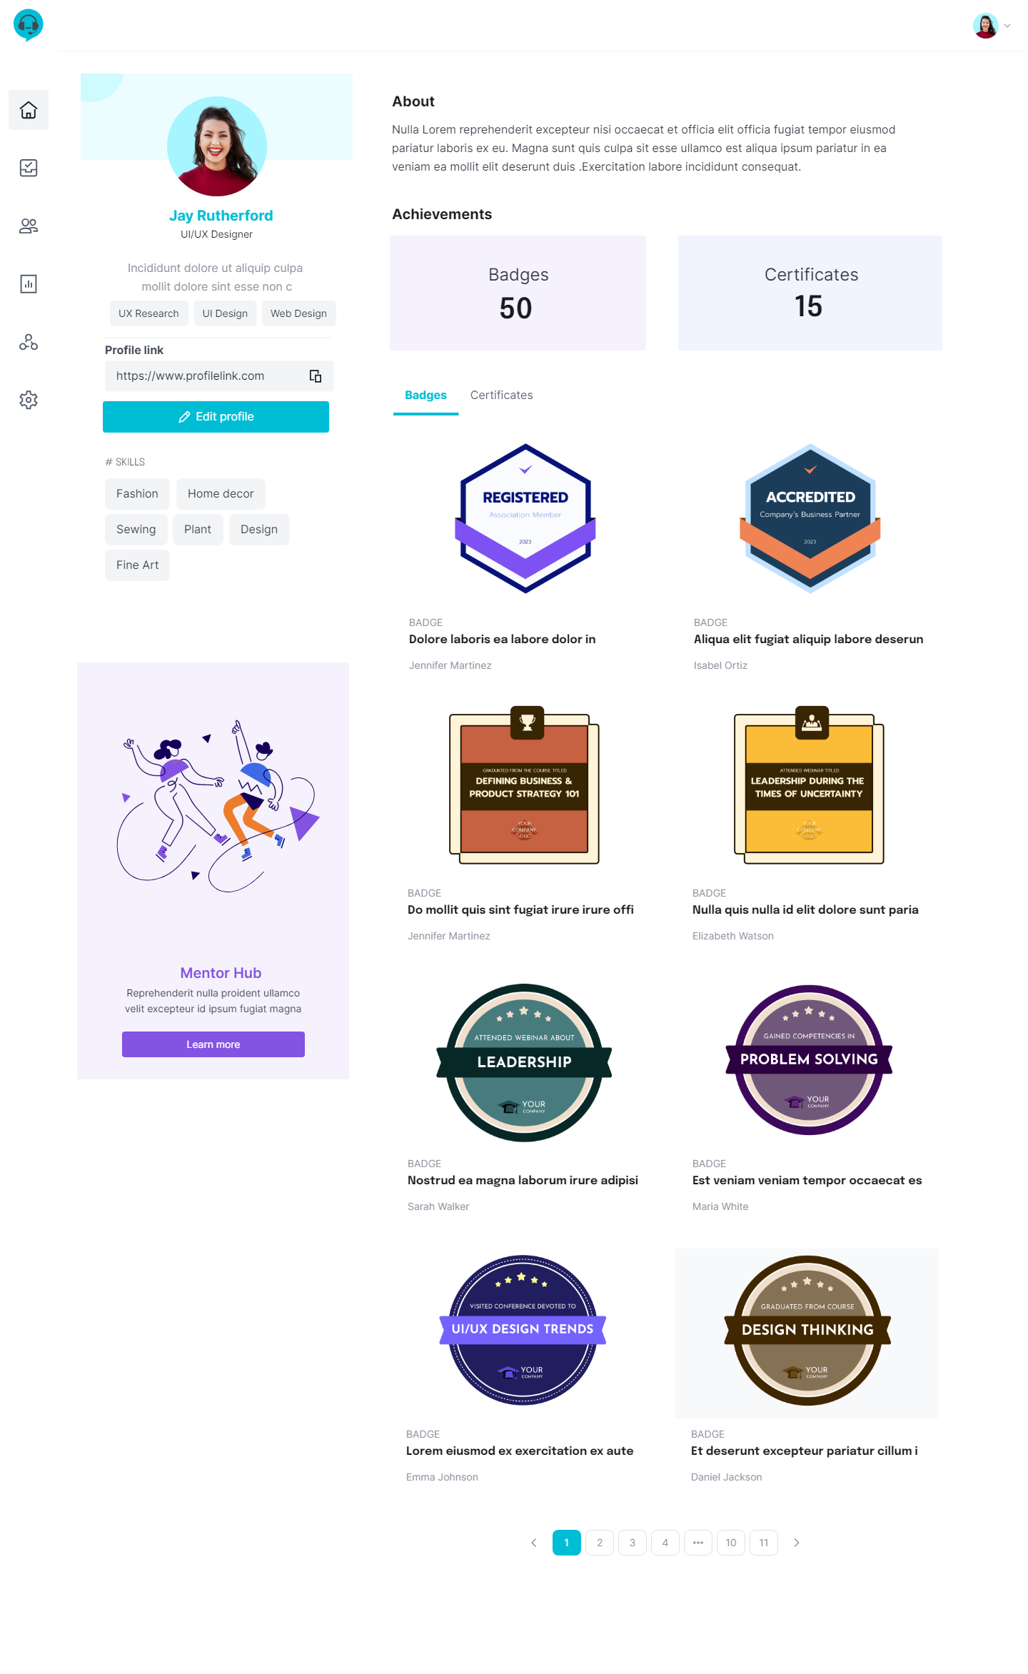
Mentee Profile

Slide 21

Mentee Profile

Slide 22
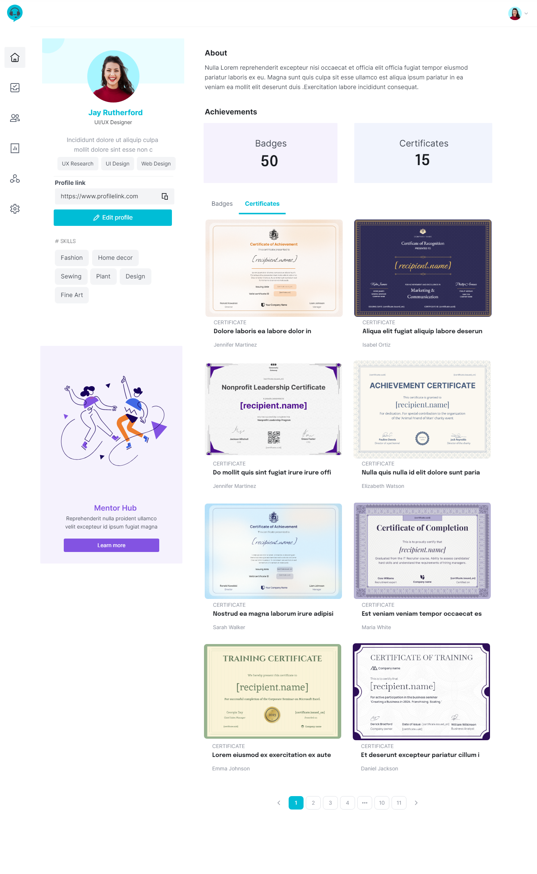
Mentee Profile

Slide 23
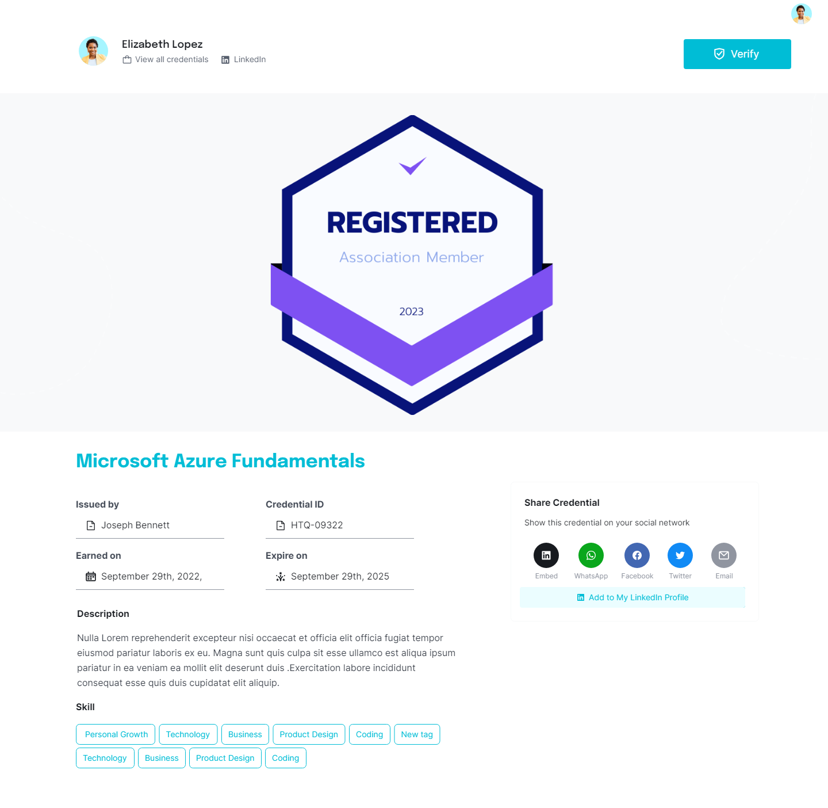
Mentee Verification

Slide 24
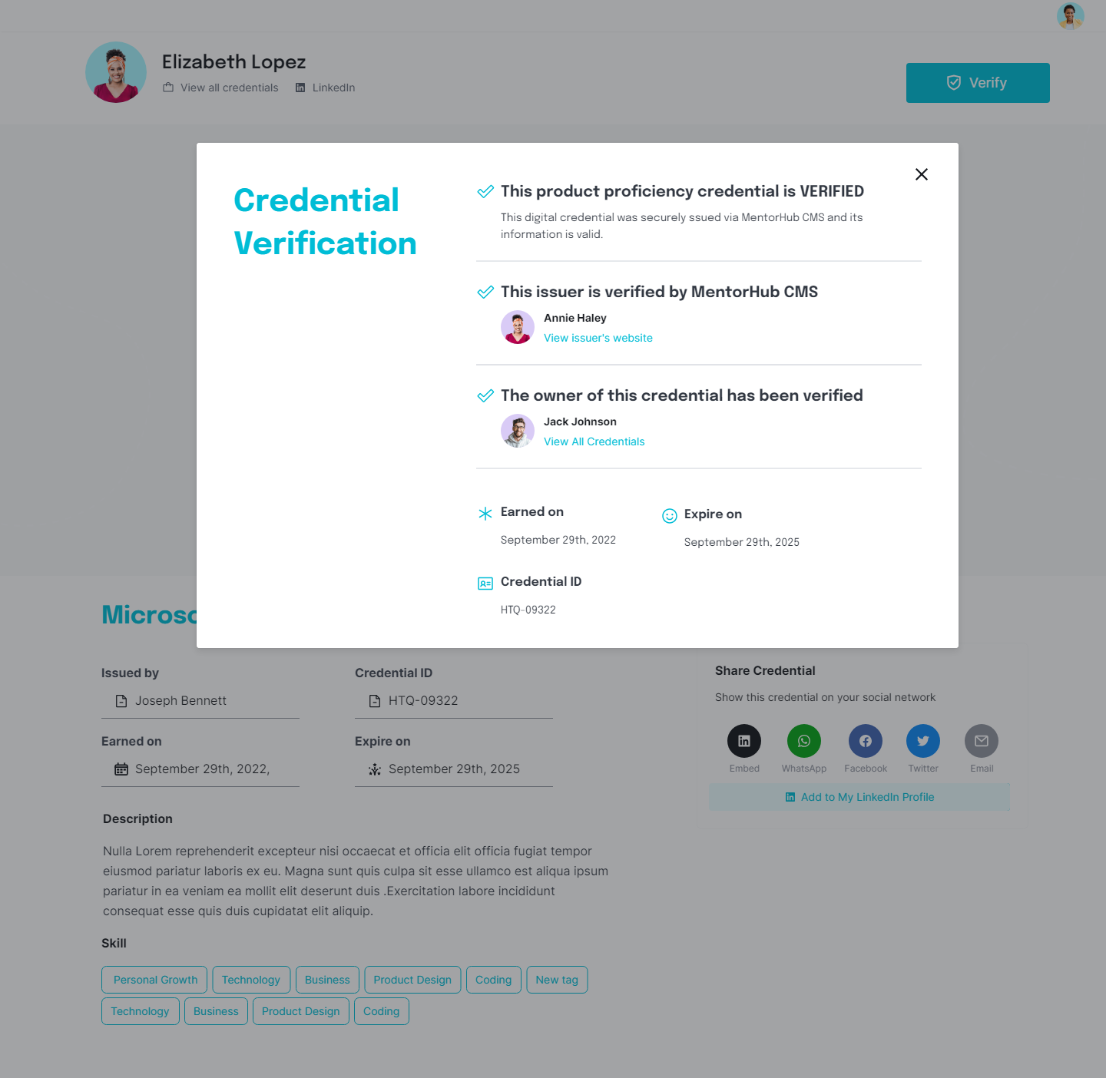
Mentee Verification

Slide 25
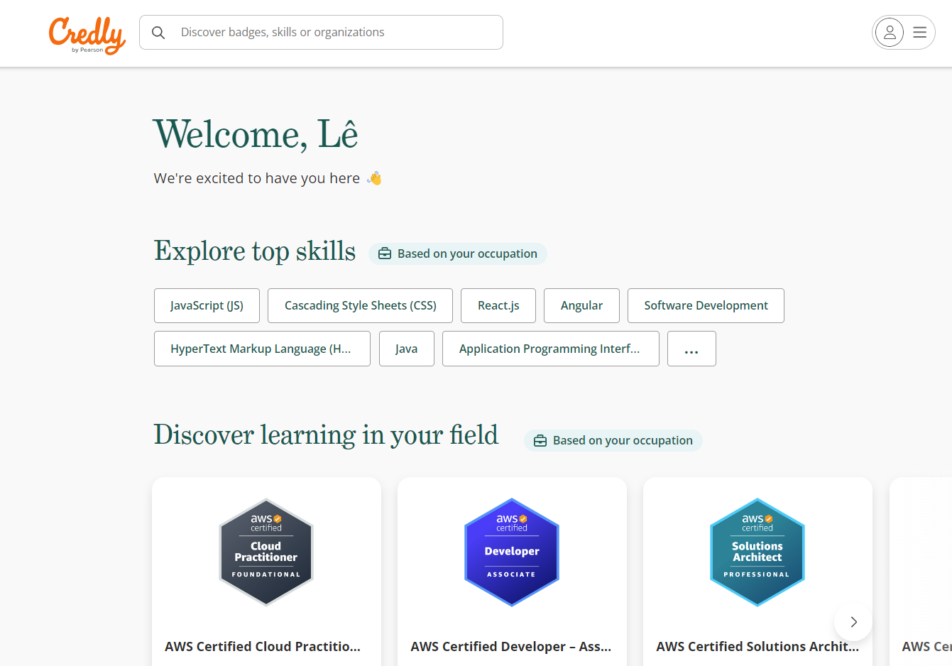
References

Slide 26
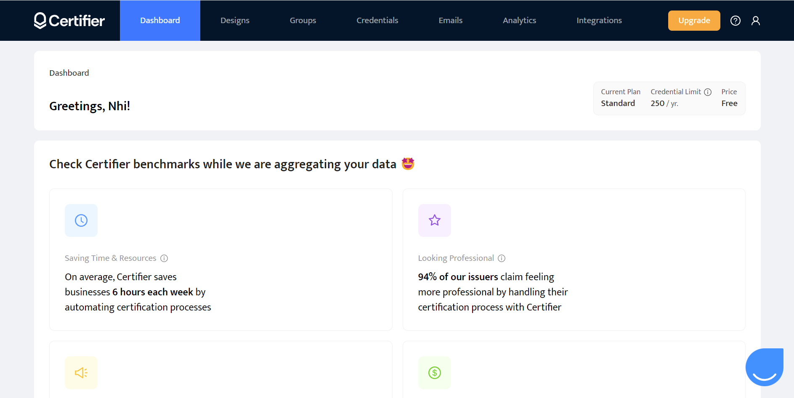
References

Slide 27
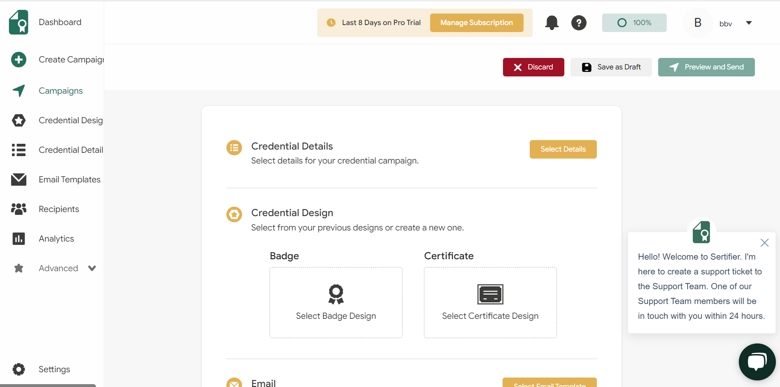
References

Slide 28
THANK YOU

Slide 29
Q&A

